Slide 1
Digital Image Processing Lecture - 3
Course Teacher:
Md. Rayhan Ahmed
Rayhan@cse.uiu.ac.bd

Slide 2
Sampling and Quantization
Objective –
To generate digital images from sensed data.
The output of most sensors is a continuous voltage waveform whose amplitude and spatial behavior are related to the physical phenomenon being sensed.
We need to convert the continuous sensed data into a digital format.
Techniques –
1. Sampling
2. Quantization

Slide 3
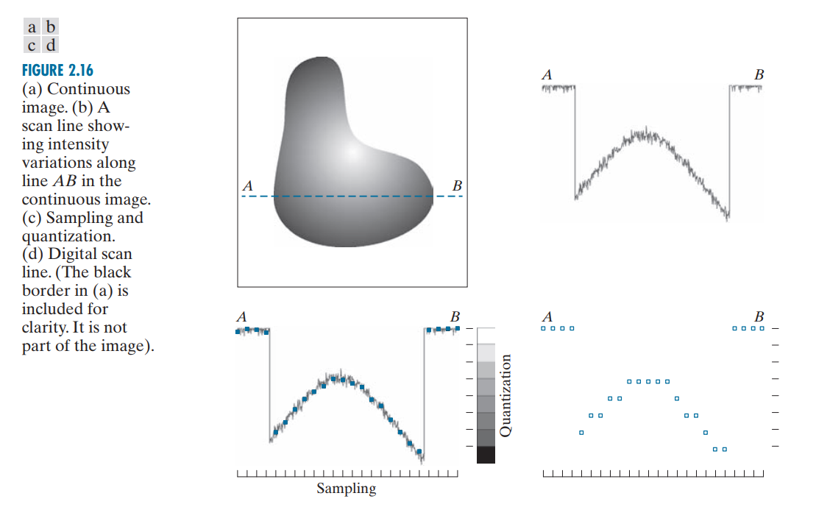
Sampling and Quantization
An image may be continuous with respect to the x- and y-coordinates, and also in amplitude.
To digitize it, we have to sample the function in both coordinates and also in amplitude.
Digitizing the coordinate values is called sampling.
Digitizing the amplitude values is called quantization.

Slide 4
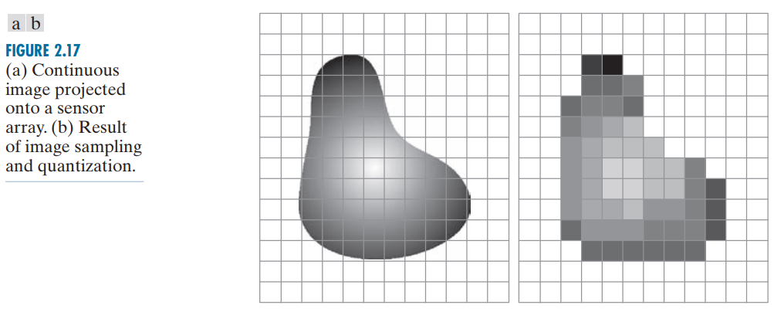
Sampling and Quantization

Slide 5
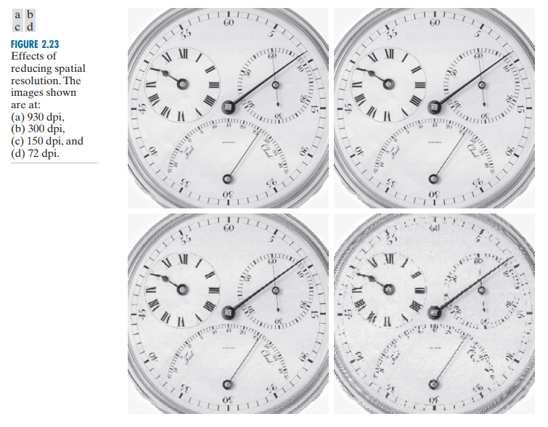
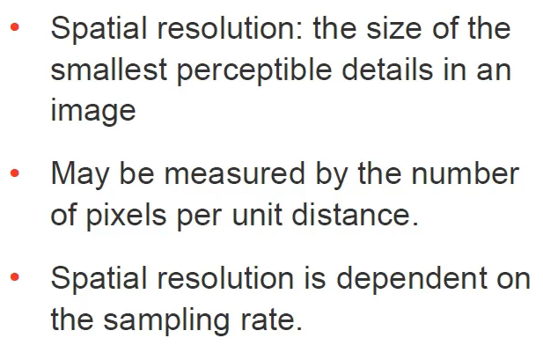
Spatial Resolution

Slide 6
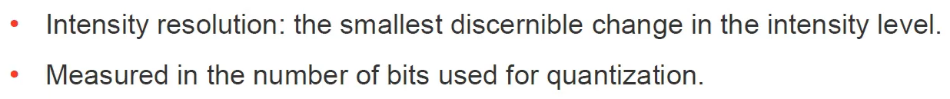
Intensity Resolution

Slide 7
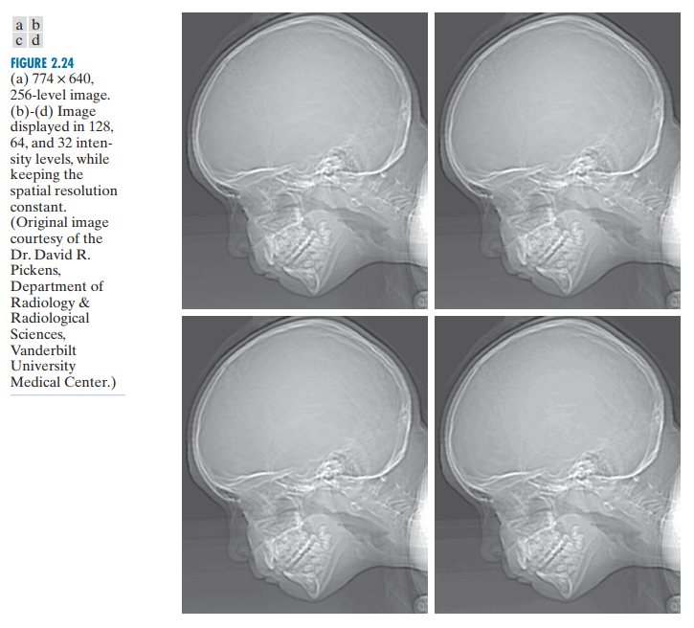
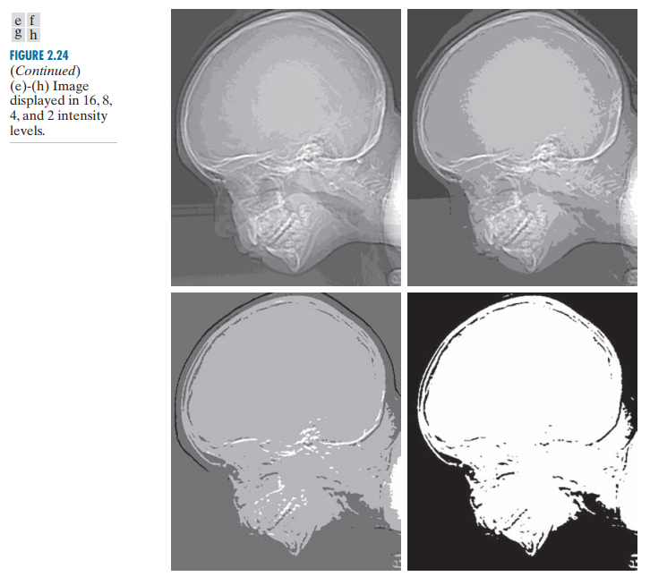
Intensity Resolution

Slide 8
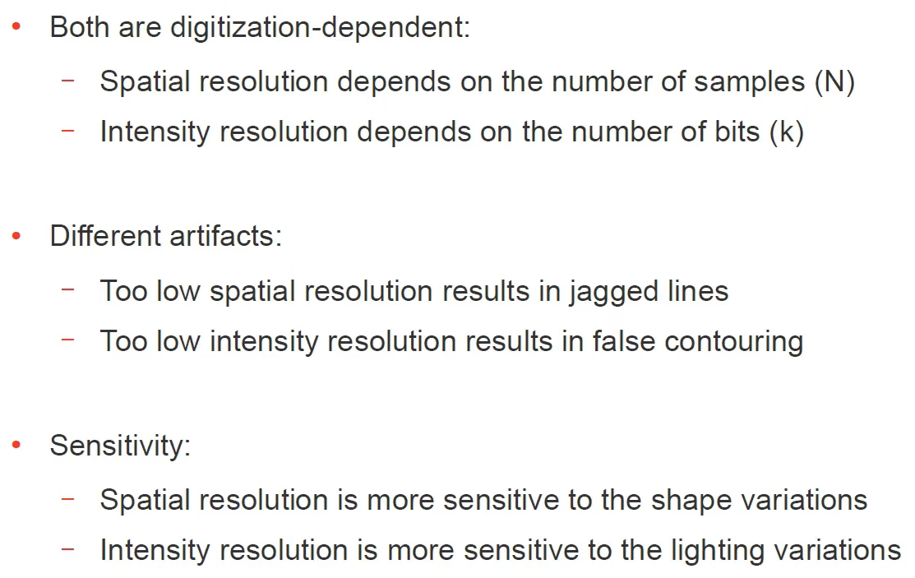
Spatial and Intensity Resolution

Slide 9
Some ways to display and resize images in python
Link:
https://www.askpython.com/python/examples/display-images-using-python
Link:
https://www.dopinger.com/blog/how-to-resize-an-image-in-python

Slide 10
Basic relationship between pixels NEIGHBORS OF A PIXEL
Any image can be represented as following:
y+1 | (x-1,y+1) | (x,y+1) | (x+1,y+1)
y | (x-1,y) | (x,y) | (x+1,y)
y-1 | (x-1,y-1) | (x,y-1) | (x+1,y-1)
 | x-1 | x | x+1

Slide 11
Basic relationship between pixels
NEIGHBORS OF A PIXEL
A pixel p at (x,y) has 4-horizontal/vertical neighbors at (x+1,y), (x-1,y), (x,y+1) and (x,y-1). These are called the 4-neighbors of p : N4(p).
A pixel p at (x,y) has 4 diagonal neighbors at (x+1,y+1), (x+1,y-1), (x-1,y+1) and (x-1,y-1). These are called the diagonal-neighbors of p : ND(p).
The 4-neighbors and the diagonal neighbors of p are called 8-neighbours of p : N8(p).
N8(P) = N4(P)+ND(P)

Slide 12
ADJACENCY, CONNECTIVITY
Two pixels that are neighbors and have the same gray level are adjacent.
In binary images, 2 pixels are adjacent if they are neighbors & have some intensity values either 0 or 1.
In gray scale, image contains more gray level values in range 0 to 255.
1. 4-adjacency. Two pixels p and q with values from V are 4-adjacent if q is in the set N4(p).
2. 8-adjacency. Two pixels p and q with values from V are 8-adjacent if q is in the set N8(p).
3. m-adjacency (also called mixed adjacency). Two pixels p and q with values from V are m-adjacent if
(a) q is in N4(p), or
(b) q is in ND(p) and the set N4(p) intersection ND(p) has no pixels whose values are from V.

Slide 13
4-adjacency
4-adjacency: Two pixels p and q with the values from set ‘V’ are 4-adjacent if q is in the set of N₄(p).
e.g. V = { 0, 1}
1 1 2
1 1 0
1 0 1
p in RED color
q can be any value in green color.

Slide 14
8-adjacency
8-adjacency: Two pixels p and q with the values from set ‘V’ are 8-adjacent if q is in the set of N₈(p).
e.g. V = { 1, 2}
0 1 1
0 2 0
0 0 1
p in RED color
q can be any value in green color

Slide 15
Mixed (m)-adjacency
m-adjacency: Two pixels p and q with the values from set ‘V’ are m-adjacent if
q is in N₄(p) OR
q is in N_{D}(p) & the set N₄(p) n N₄(q) have no pixels whose values are from ‘V’.
e.g. V = { 1 }
0 a 1 b 1 c
0 d 1 e 0 f
0 g 0 h 1 i

Slide 16
m-adjacency
q is in N₄(p) OR
q is in N_{D}(p) & the set N₄(p) n N₄(q) have no pixels whose values are from ‘V’.
e.g. V = { 1 }
(i) b & c
0 a 1 b 1 c
0 d 1 e 0 f
0 g 0 h 1 I
Soln: b & c are m-adjacent.

Slide 17
m-adjacency
q is in N₄(p) OR
q is in N_{D}(p) & the set N₄(p) n N₄(q) have no pixels whose values are from ‘V’.
e.g. V = { 1 }
(ii) b & e
0 a 1 b 1 c
0 d 1 e 0 f
0 g 0 h 1 I
Soln: b & e are m-adjacent.

Slide 18
m-adjacency
q is in N₄(p) OR
q is in N_{D}(p) & the set N₄(p) n N₄(q) have no pixels whose values are from ‘V’.
e.g. V = { 1 }
(iii) e & i
0 a 1 b 1 c
0 d 1 e 0 f
0 g 0 h 1 I
Soln: e & i are m-adjacent.

Slide 19
m-adjacency
q is in N₄(p) OR
q is in N_{D}(p) & the set N₄(p) n N₄(q) have no pixels whose values are from ‘V’.
e.g. V = { 1 }
(iv) e & c
0 a 1 b 1 c
0 d 1 e 0 f
0 g 0 h 1 I
Soln: e & c are NOT m-adjacent.

